Slide 1

Selenium Automation Framework
Java 17 • TestNG • Smart Actions • AI Auto‑Healing (Optional)
Automation Assignment • Framework Demo

Slide 2
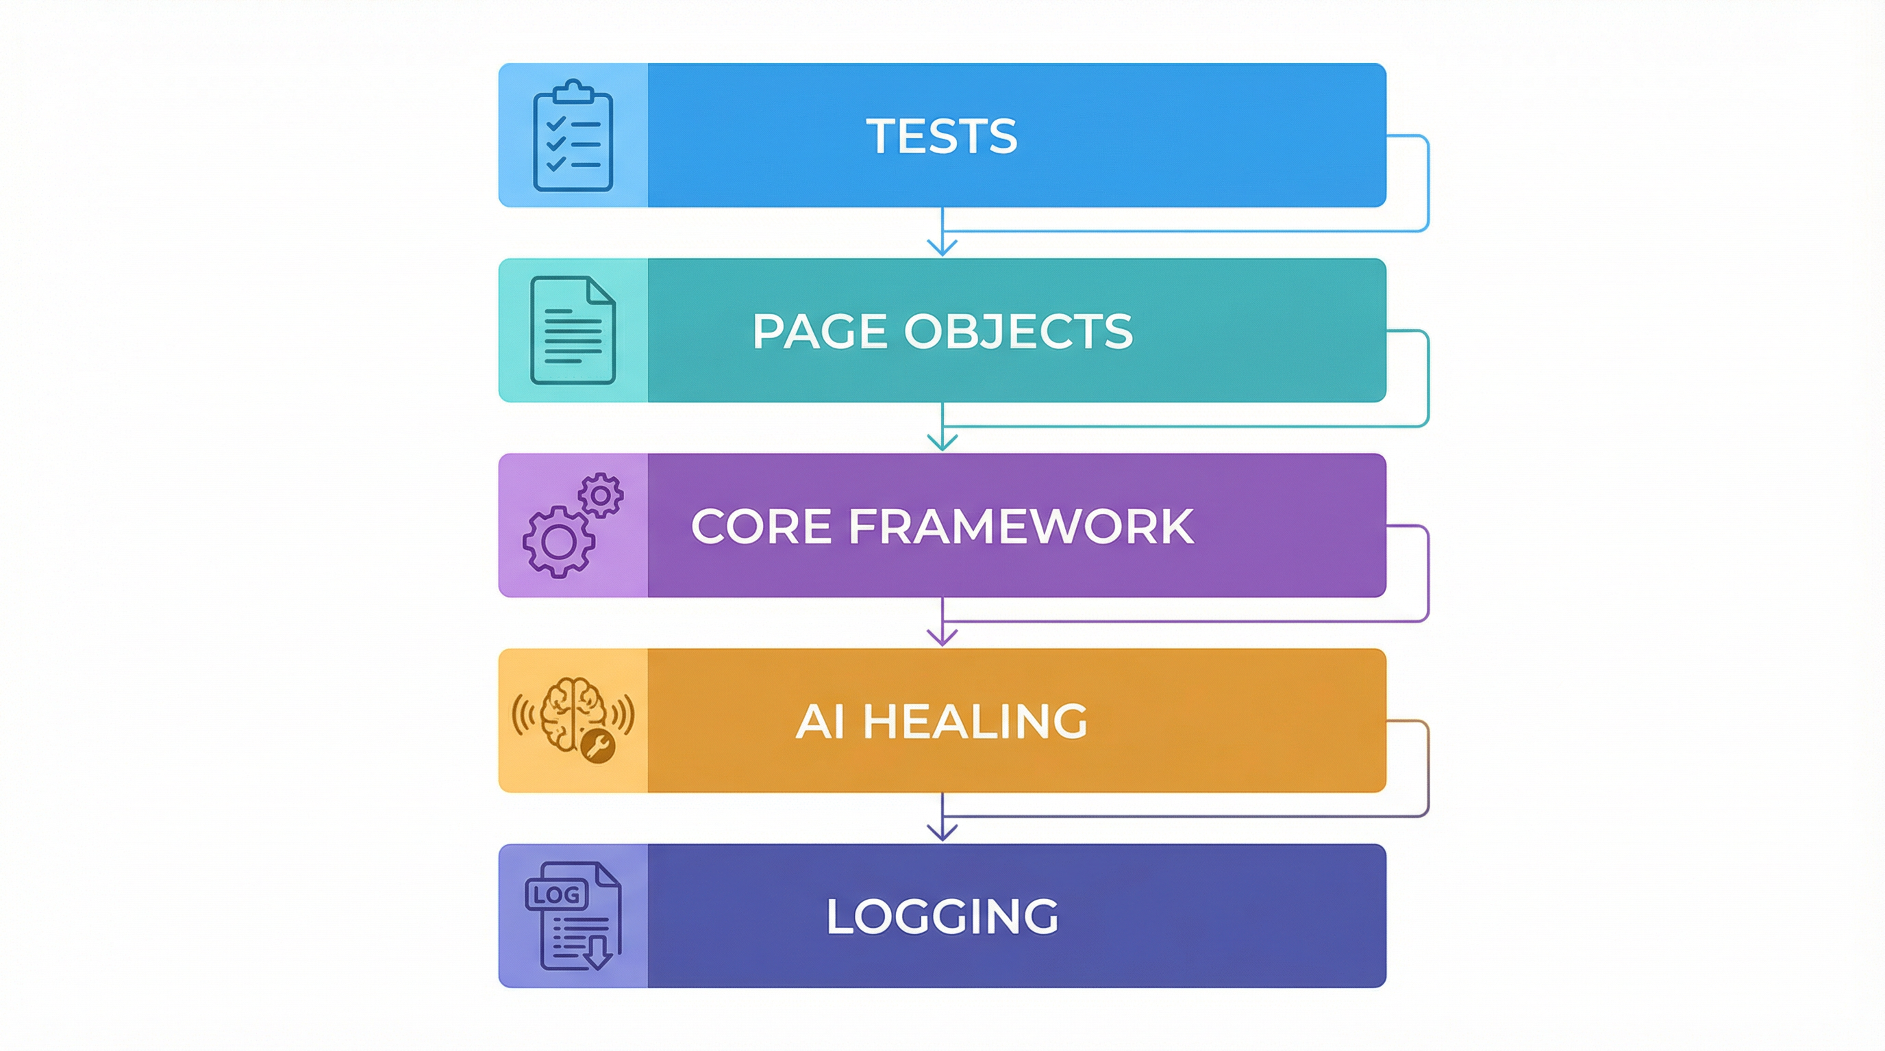
What this framework delivers
Maintainability • Stability • Resilience
Stability
Explicit waits
Maintainability
POM + annotations
Resilience
AI healing + audit
Low setup with Selenium Manager
Centralized waits + smart actions
Safety: redaction, cache, validation
Slide 2/10

Slide 3
The problem we solve
UI changes cause fragile selectors and maintenance cost
UI Changes
Broken Selectors
Test Failures
Maintenance Cost
Flaky runs due to timing and dynamic DOM
Selector churn during UI releases
Boilerplate waits and locators repeated across tests
Limited traceability on what changed and why
Slide 3/10

Slide 4
Architecture overview
Layered design with clear responsibilities
Tests (TestNG): call page actions
Pages: business actions + @SeleniumSelector
Core: waits + smart actions + element wiring
AI (optional): healing with audit log
Utilities: JSON + HTML cleaning
Slide 4/10

Slide 5
Core implementation
How the framework works under the hood
SeleniumFactory (WebDriver lifecycle)
ElementInitializer (reflection wiring)
Explicit waits (10s default)
CSS selectors by default
XPath via prefix: xpath=...
Minimal boilerplate in tests
BasePage (waits + smart actions)
SmartElement (By + driver)
Slide 5/10

Slide 6
Smart Actions
Stable by default; healing only on failure
smartClick(selector): wait → click
smartFill(selector, value): wait → clear → type
On TimeoutException → healing attempt (1 retry)
StaleElementReferenceException → retry once (no AI)
Parse selector → By
Explicit wait (visibility/clickable)
Perform action (click/type)
If timeout → AI heal → validate → retry once
Slide 6/10

Slide 7
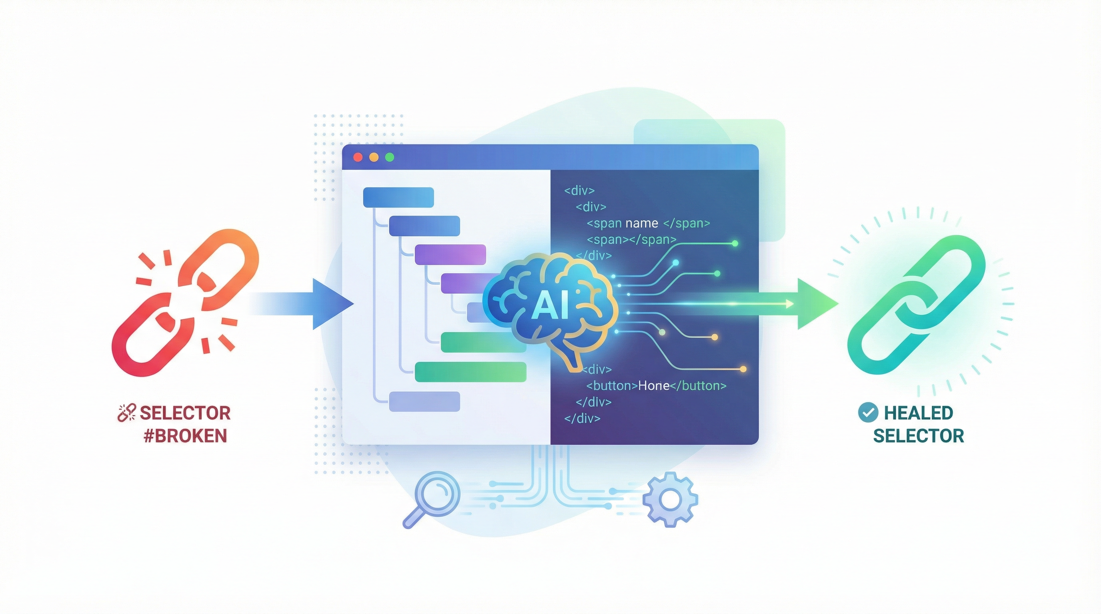
AI Healing pipeline
Optional • audited • designed with safety guardrails
Trigger: action times out (TimeoutException)
Capture HTML via getPageSource()
Clean + redact sensitive values (best-effort)
Ask LLM for replacement selector (if configured)
Validate healed selector → retry once
Audit log: logs/ai-healing-audit.log
Slide 7/10

Slide 8
AI hardening (real projects)
Redaction • Healing cache • Selector validation
Cache lookup healing-cache.json
Validate selector (unique + actionable)
Retry once (or bypass cache)
Cache reduces repeated LLM calls and speeds up healing
Validation prevents wrong/stale selectors from hiding real issues
If cached selector is invalid: bypass cache once and request fresh heal
Override cache path: mvn test -Dhealing.cache.path=...json
Slide 8/10

Slide 9
Demo story
Login test flow + evidence artifacts
Test creates driver via SeleniumFactory
LoginPage exposes clear actions (enterUsername, enterPassword, clickLogin)
Smart actions add stability and optional healing on failures
Evidence: ai-healing-audit.log + healing-cache.json
Run: mvn test
Audit: logs/ai-healing-audit.log
Cache: healing-cache.json
Slide 9/10

Slide 10
Why this framework
Clean • Reliable • Explainable • Resilient
Clarity
Page Object Model
Designed to reduce flakiness and locator maintenance
AI hardening: redaction + cache + validation guardrails
Audit trail provides traceability for assignments and real teams
Future scope: ThreadLocal drivers, reporting, screenshots
Reliability
Explicit waits
Resilience
AI healing (optional)
Thank you — Questions?
Slide 10/10

